Slide 1
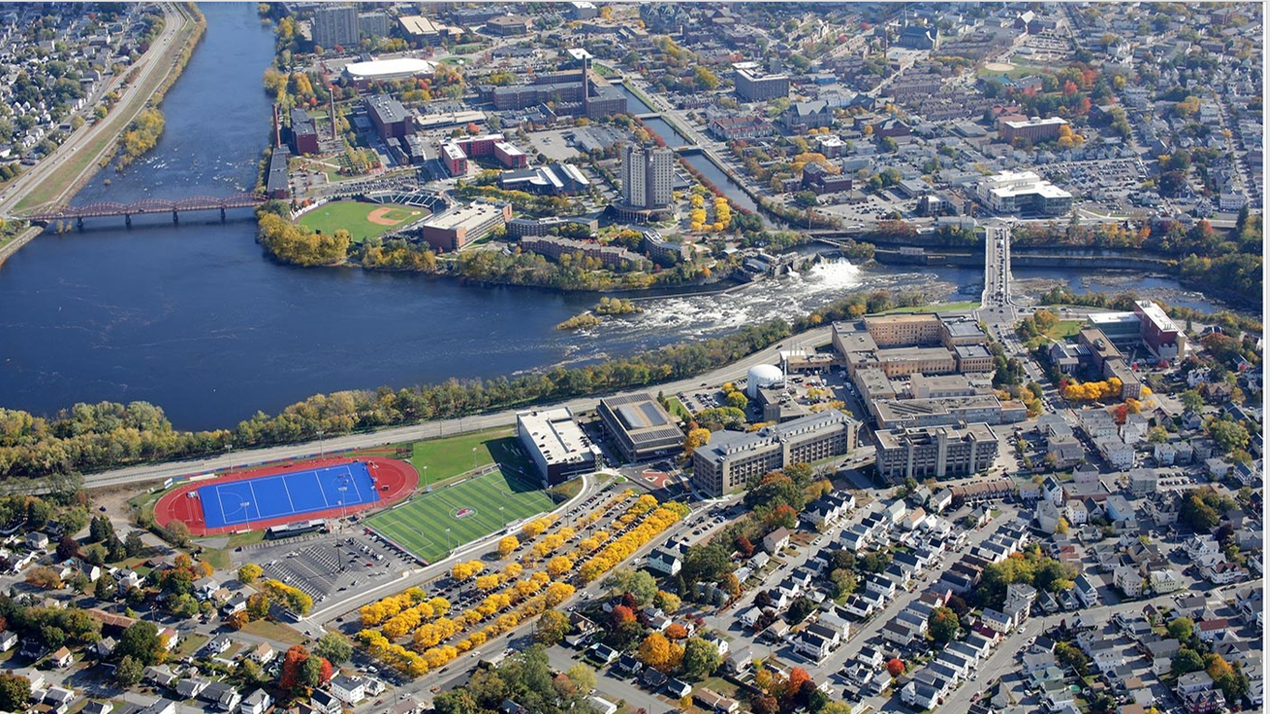
Plastics Engineering
At The University Of Massachusetts Lowell

Slide 2

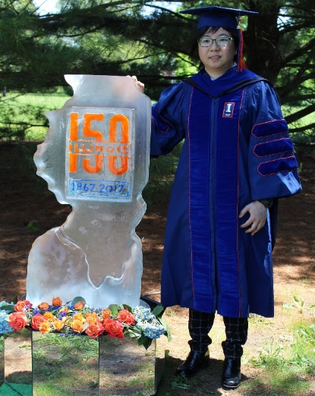















My background…
M.S. in ABE, University of Illinois Urbana-Champaign
Postdoc at School of Chemical Engineering, Purdue University
2011
2013
2017
2018
Present
PhD in ABE, University of Illinois Urbana-Champaign
Asst. Prof. in Plastic Engineering, University of Massachusetts Lowell
B.S. in Chemical Engineering , National Taiwan University

Slide 3
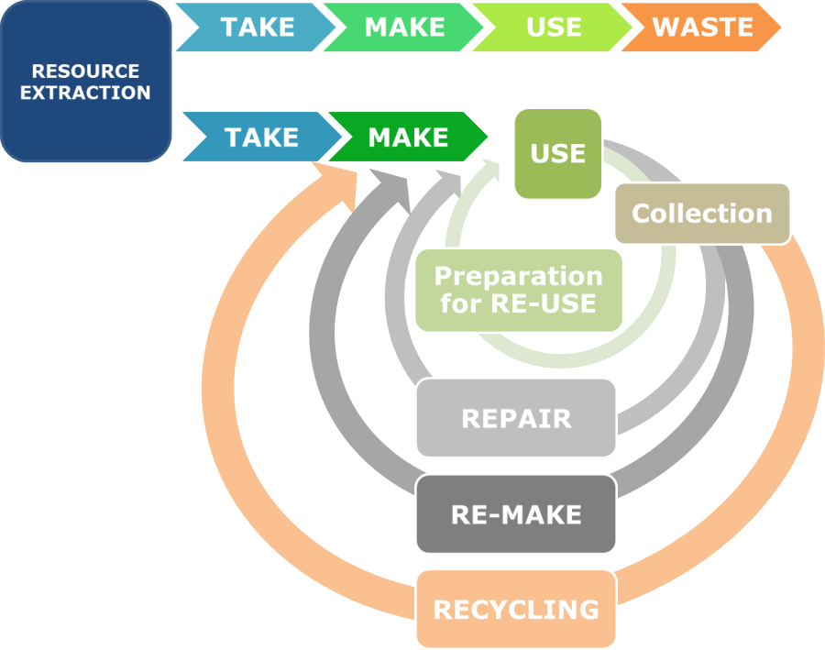
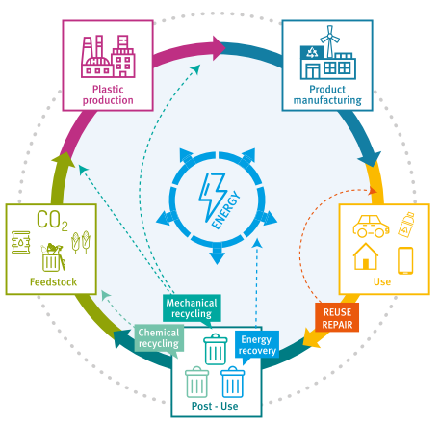
Advocate of a sustainable and circular economy!
Linear economy
Circular economy
Image: PlasticsEurope (2018)
Circular economy for sustainable resource management
Image: Niero (2016) “How to Bridge the Gap Between the Packaging Sector and Circular Economy” Carlsburg Foundation
At the end of their life, Plastics are still very valuable resources that can be transformed into new feedstock or into Energy!

Slide 4
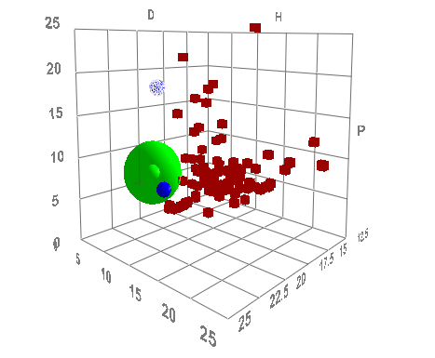


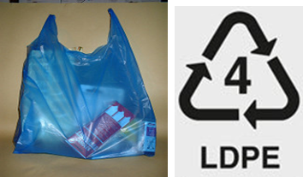


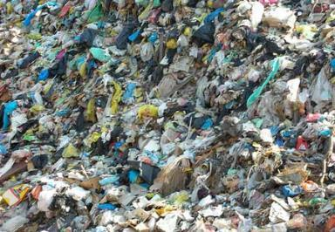

Hydrothermal Processes
Selective Solvent Extraction
Biodegradation
Plastics and Environment Research Laboratory
PERL

Slide 5
Ongoing Research Programs at the PERL Group
Plastic Recycling
  Hydrothermal processes to covert ocean plastic waste into fuels, aromatics, or monomers.
  Smart solvent formulations to extract valuable plastics, additives, and metals.
  Microplastic pollutants mitigation and separations.
Bioplastic Development
  Biodegradable mulch films from soy waste.
  Degradation mechanism in packaging barrier materials.
  Biobased polyol and polyurethane synthesized from biowaste.
LCA/TEA

Slide 6
How do I get here?

Slide 7
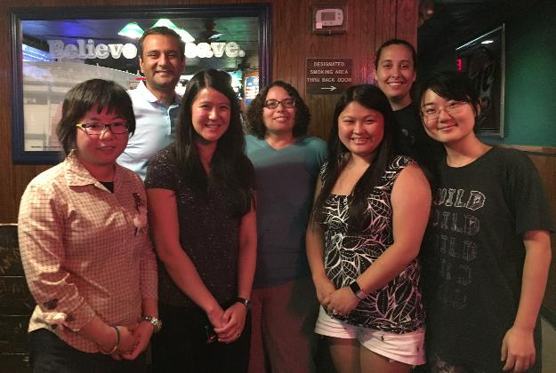
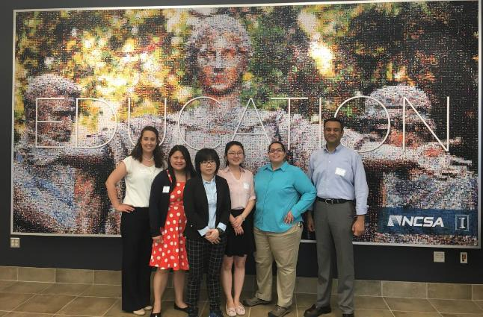
Illinois Female Engineering Student in Academia Training (iFEAT)
Opportunities to grow network outside of my comfort zone
  Interview previous UIUC chancellor, the Dean of Engineering College, the directors of MRL and Beckman Institute at UIUC
Coordination of a year-long program that involves more than 15 students/postdocs and 30 faculties
First time to participate in an Engineering Education (EE) Project
Prepare proposals and present EE research results in ASEE
Notes:
A Unique Experience (PNNL)

Slide 8
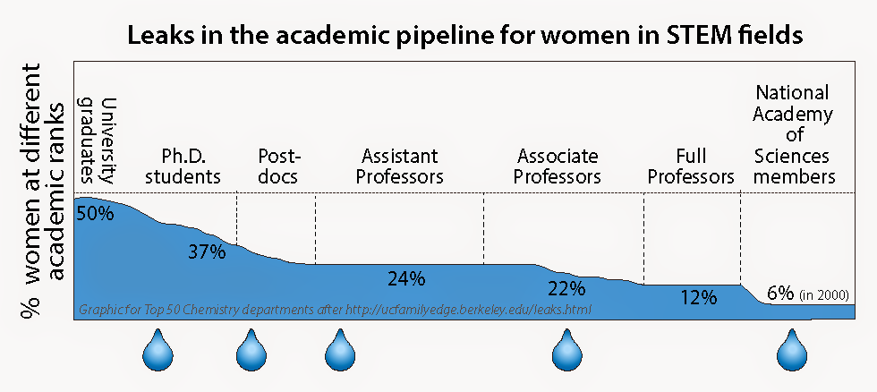
The Gender Gap within STEM
Potential Causes of the “Leaky Pipeline”?
lack of role models in the upper divisions of academia
low self-confidence
poor student impressions of work-life balance in academia
Notes:
From 2002-2012, women were conferred ~40% of doctoral degrees in STEM fields yet in 2010, women accounted for only 27% of tenure-track assistant professorships in engineering.
In a 2006 survey, 70% of first year female students planned to be in a research career, yet only 37% had that goal by their third year

Slide 9
First, Why academia?

Slide 10
Before you apply
Know what type of institution you’re interested in
Know where to find job ads (e.g., Chronicle Vitae)
Culture your relationships
  3-10 references (some school asks up to 10 references)
  Attend future faculty poster session in the National level conference in your field
  Let people know you are on the job market!
Websites to read/use:
  Professor is in: http://theprofessorisin.com/
  How to Get a Professor Job in the USA, http://facultycandidate.blogspot.com/
  https://ifeat.engineering.illinois.edu/

Slide 11
Application Timeline
Submit your package (Fall)
Phone Interview (Spring or during National conference)
Skype Interview (Spring)
On-site Interview (Spring)
Offer (may have invited visitation)
https://ifeat.engineering.illinois.edu/

Slide 12
Your application package
  CV
Cover letter
Teaching Statement
Research Statement
3-10 references (some school asks up to 10 references)
Diversity Statement
Postdoc proposal (some position combines postdoc training and faculty position together)
https://ifeat.engineering.illinois.edu/

Slide 13
Phone Interview
Prepare short (~2 min) and long (~5-7 min) version of answers
Prepare answers for questions regarding
  Research experience (novelty)
  Teaching experience
  Mentoring experience
  Proposal writing experience
  3~5 year plan of your lab
  Diversity/Inclusion promotion
May have two rounds
  First round is 10-15 minutes--Usually by phone.
  Second round is 20-30 minutes—may need to give a formal presentation.
https://ifeat.engineering.illinois.edu/

Slide 14
On Site Interview
Whole day process!
Multiple faculty interviews
Deliver seminar
Meet students
Sample lecture
Chalk talk of future research ideas
You’re interviewing them too!
Virtual version would follow the same format!
https://ifeat.engineering.illinois.edu/

Slide 15
Post Interview
Follow-up visit
Negotiation
  List what you need as a reasonable startup package
  Discuss with future colleagues or your advisors

Slide 16

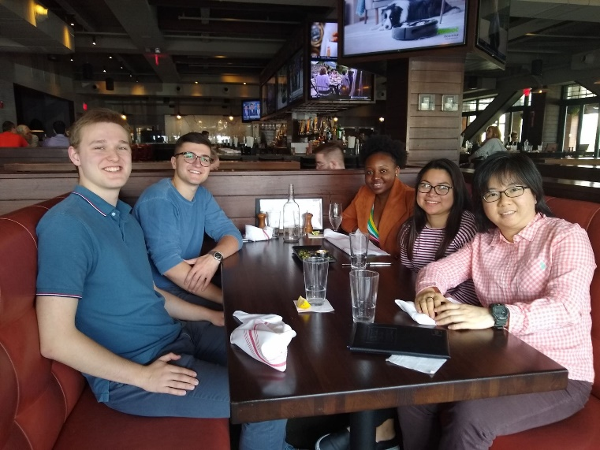
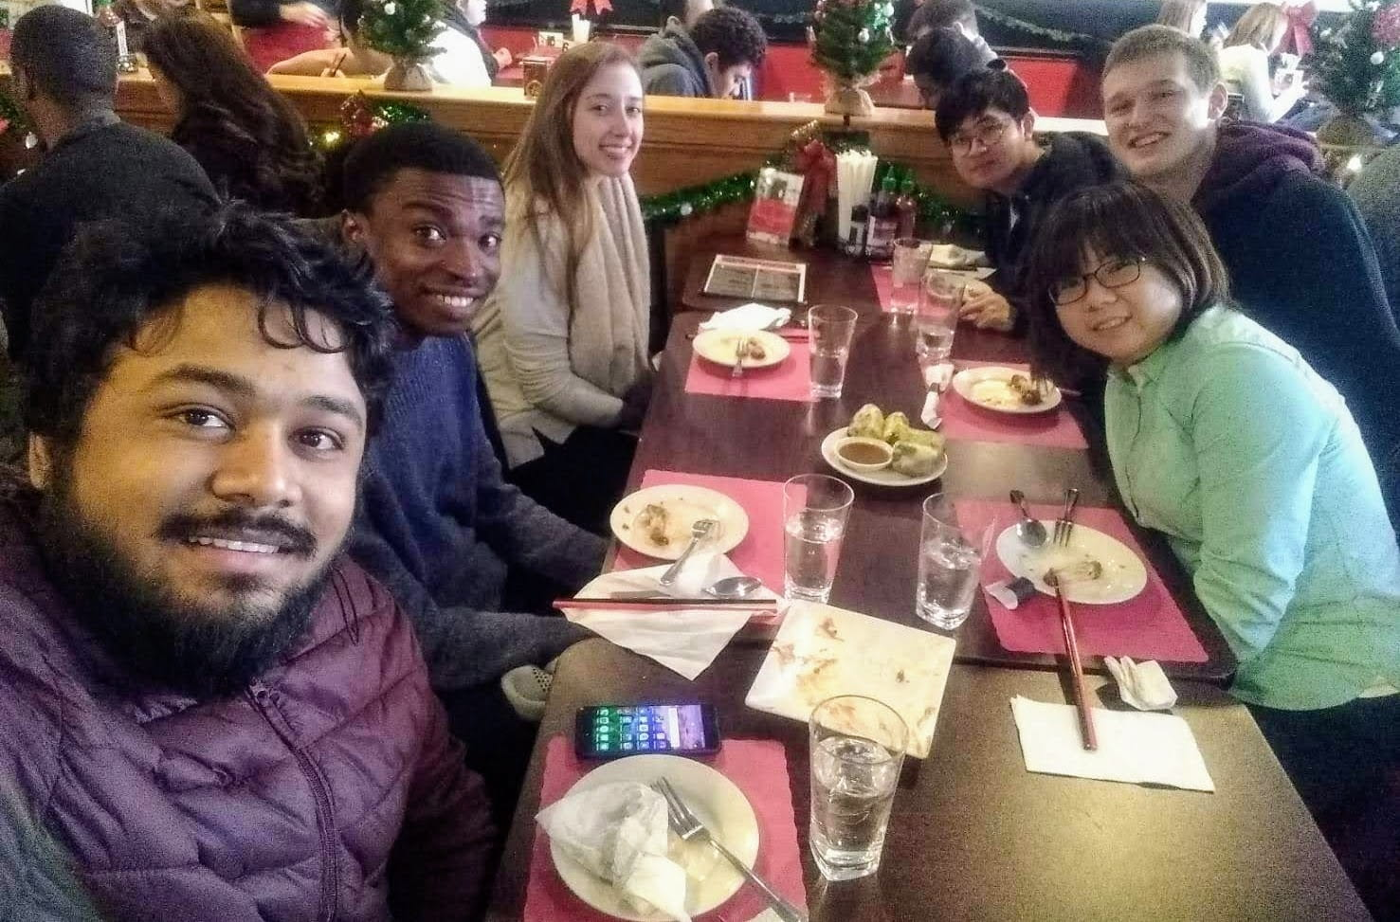
Thank you and any questions?
We are seeking feedback, collaborations and commercialization partners.
Feel free to contact us:
  Prof. Wan-Ting (Grace) Chen, WanTing_Chen@uml.edu

Slide 17
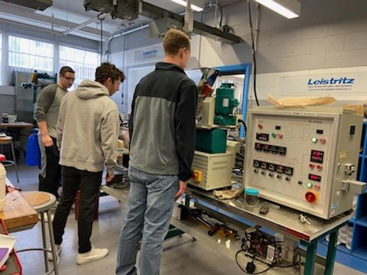
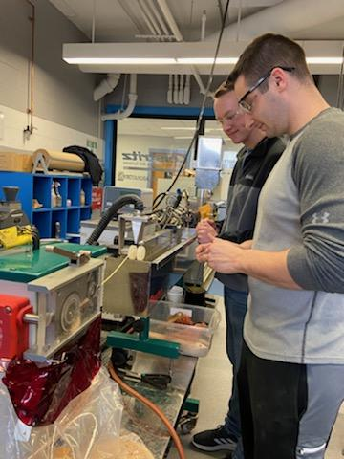
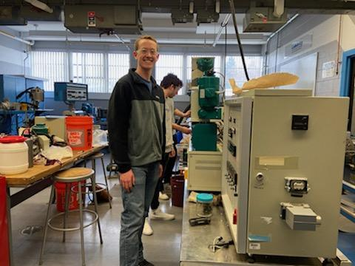
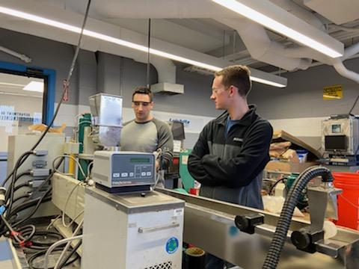
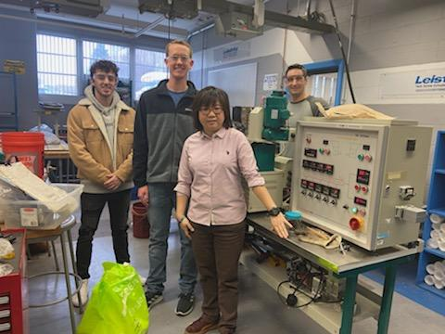
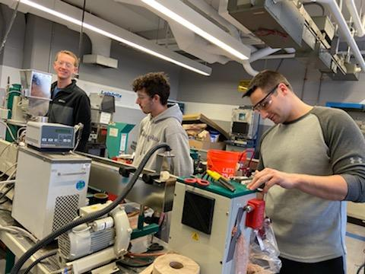

Slide 18











Acknowledgement for Funding agencies

Slide 19
Backup slides

Slide 20
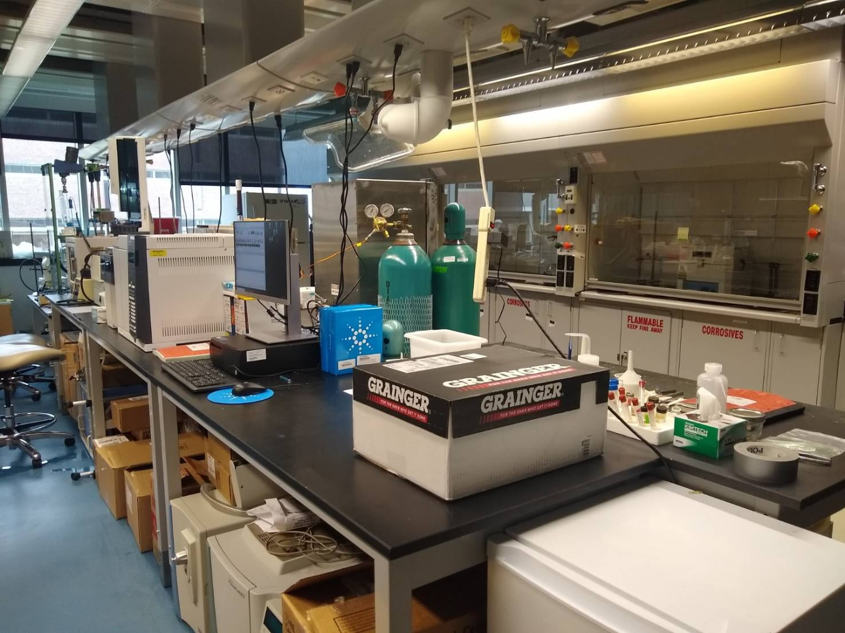
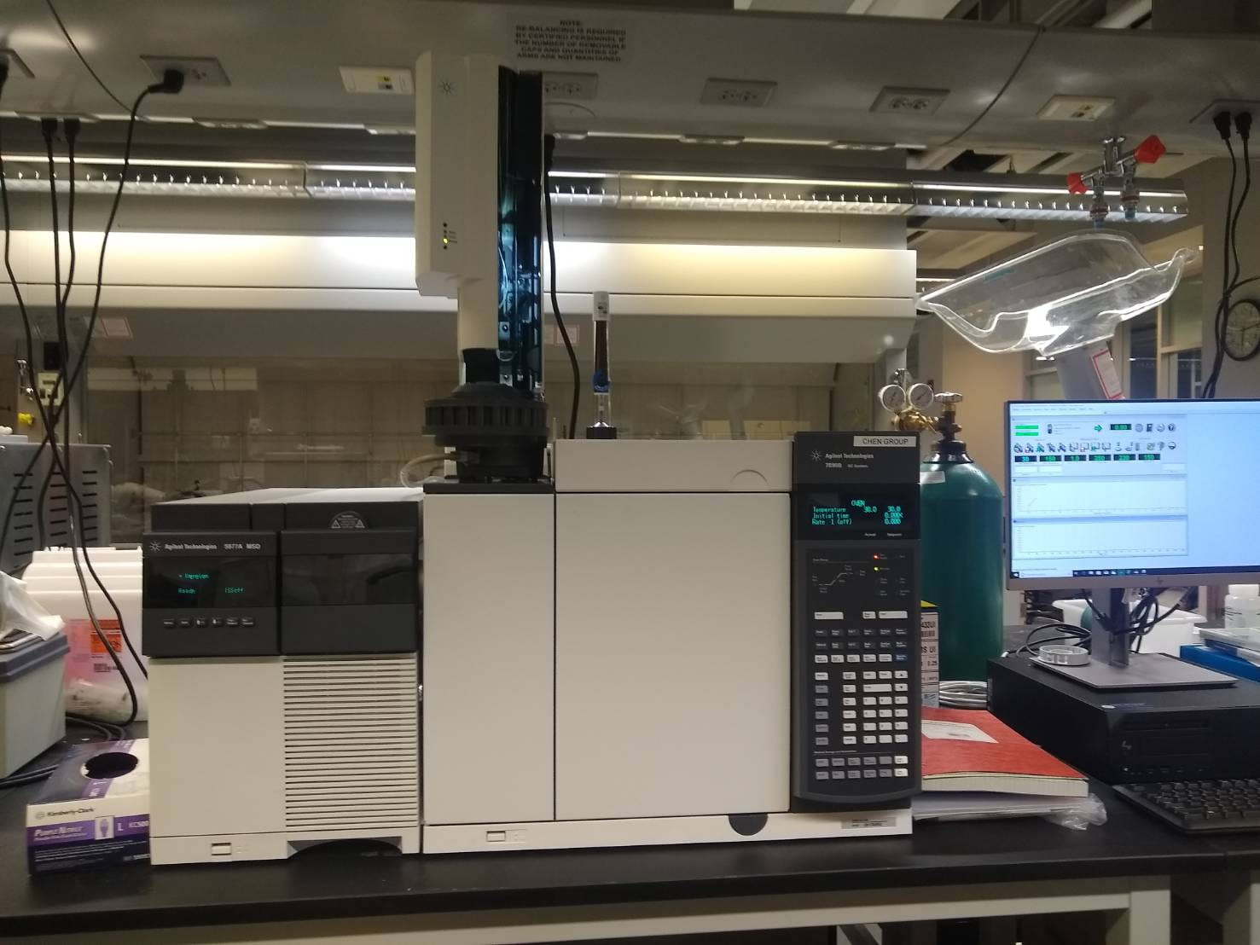
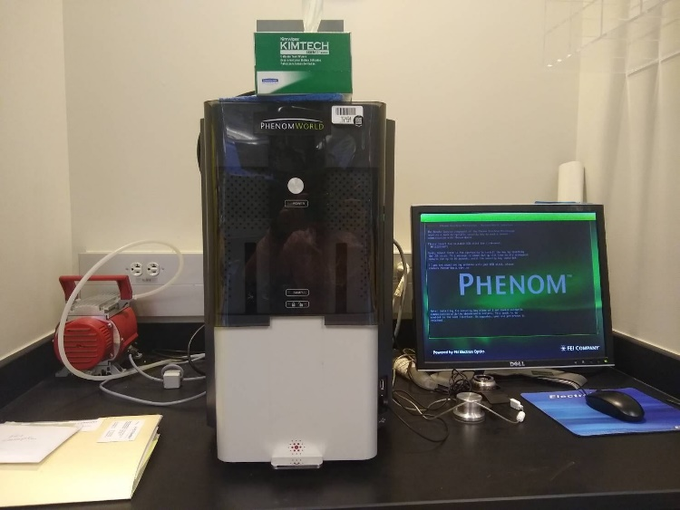
The PERL Group

Slide 21
